Slide 1
Iteration 1
Decomposition
The geographical location of an individual.
The type of illness that a person may have
The medium of transportation used to travel to their destination.
A persons background, whether a civilian or an ambulance driver
Problem Identification
The availability of some care services are not always accessible by people around the Philippines in terms of distance. Because of this the survival rate of some patient decreases due to the distance required to travel to a further care center.
Pattern Recognition
The distance required poses a threat when it comes to the survival of an patient.
Abstraction
Relevant : Illness, Distance, Transportation
Irrelevant :
Situation of the road, whether traffic or not.
---
Graphic Organizer

Slide 2
Iteration 2
Decomposition
How to utilize the total distance to figure out the survival.
Problem Identification
How will I be able to get the least distance required in order to get to a care center?
Pattern Recognition
To get the least distance required, simply use an algorithm that can disseminate a given list in order to figure out the list distance among them. But what possible algorithm can be used?
Abstraction
Graphic Organizer

Slide 3
Iteration 3
Decomposition
How will you be able to calculate the comparison between the distance and the time.
Problem Identification
The dijkstra algorithm can be used in combination to using nodes to simulate the roads to obtain the least distance but how can the distance be used to figure out the survival of a patient?
Pattern Recognition
Utilizing both a given golden hour of an illness can be used to compare the given output of the least distance required.
Abstraction
Graphic Organizer

Slide 4
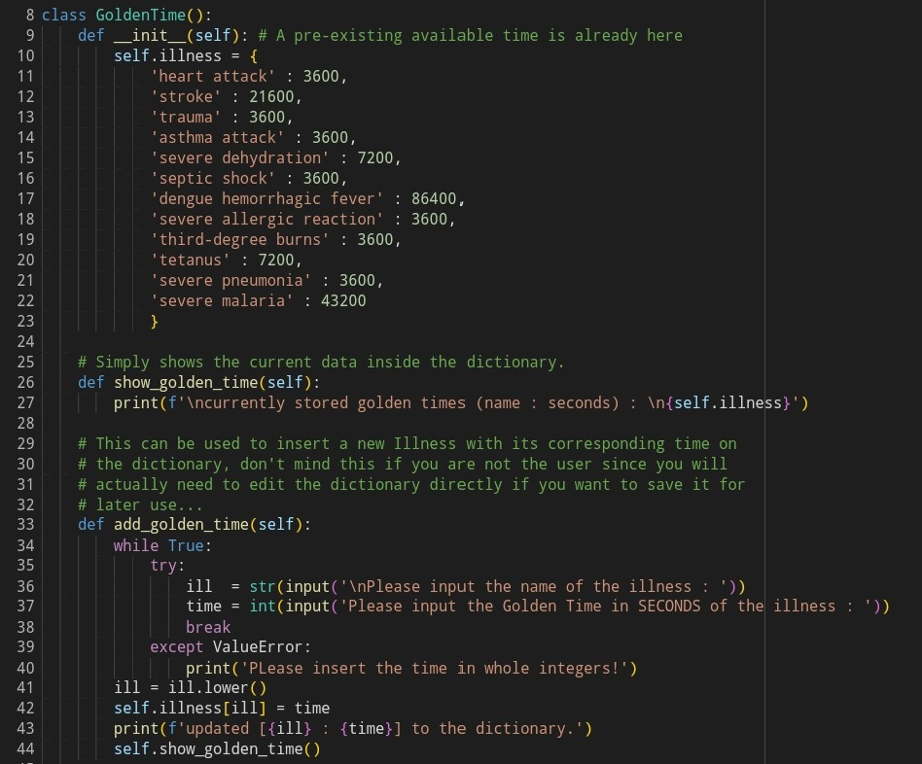
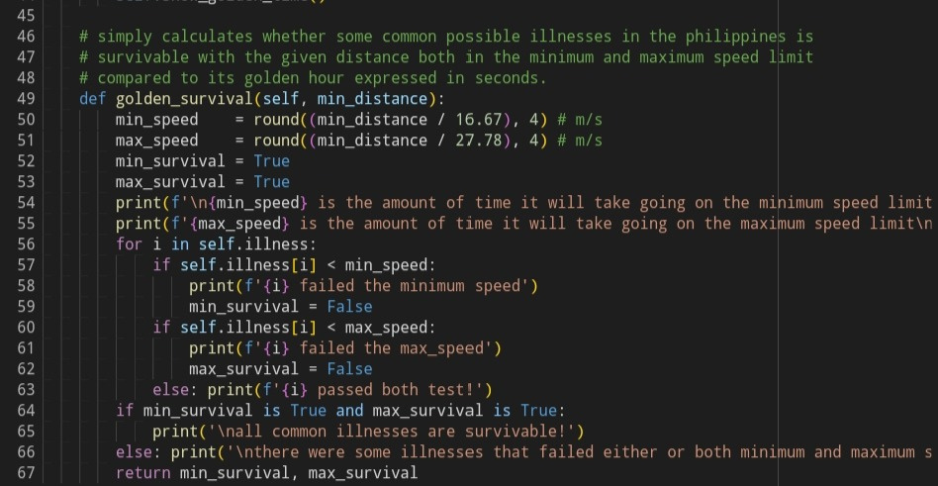
Code
Breakdown

Slide 5
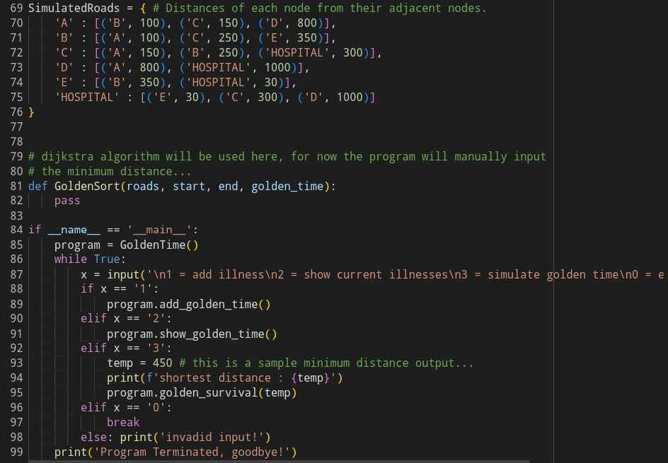
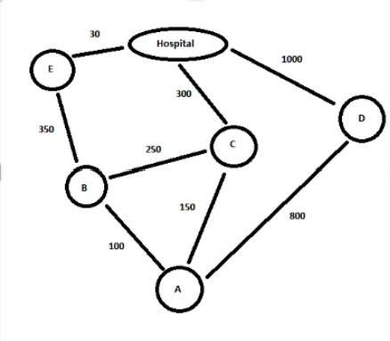
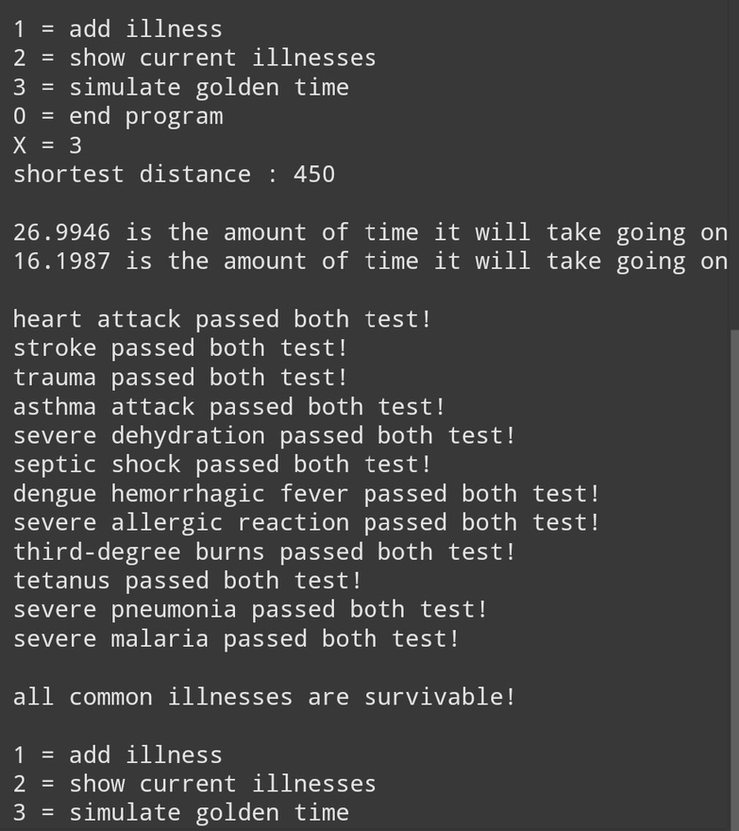
Code
Breakdown

